Slide 1
CIRCUIT AND PACKET SWITCHING

Slide 2

Contents
Introduction to Switching Technology Types of Switching Technology Circuit Switching Networks
Packet Switching Networks
Comparision b/w Datagram Network and Virtual Circuit Network Comparision of all Switching Networks.
Structure of Switching Circuit Switch Packet Switch

Slide 3
Inroduction to Switched Network
Problem: A network is a set of connected devices. Whenever we have multiple devices, we have the problem of how to connect them to make one-to-one communication possible.
Solution: Point-to-Point, Network Topology (But Impractical, Wasteful for Larger Networks)
Better Solution:
A switched network consists of a series of interlinked nodes, called switches.
Switches are devices capable of creating temporary connections between two or more devices linked to the switch.
In a switched network, some of these nodes are connected to the end systems (computers or telephones, for example). Others are used only for routing.

Slide 4
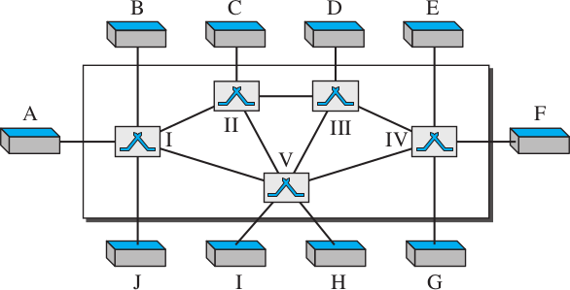
Inroduction to Switched Network
Figure:Switched network
The end systems (communicating devices) are labeled A, B, C, D, and so on, and the switches are labeled I, II, III, IV, and V. Each switch is connected to multiple links.
4/ 39

Slide 5
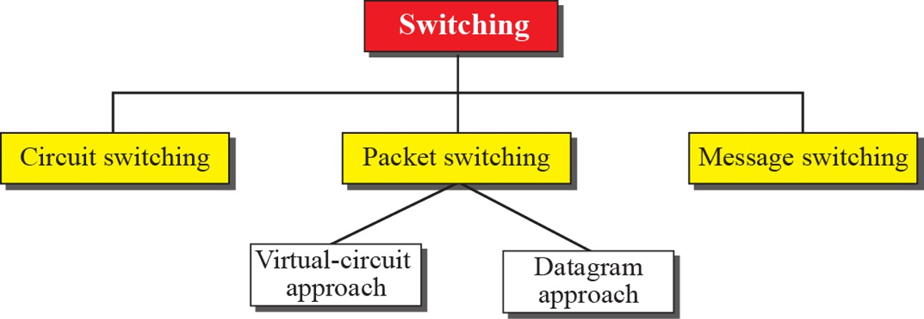
Types of Switching Network
Three Methods of Switching Circuit-Switching
Packet Switching Message Switching
Figure:Taxonomy of switched networks
5/ 39

Slide 6
Switching in TCP/IP Suite
Switching can happen at several layers of the TCP/IP protocol suite.
Switching at Physical Layer:Circuit Switchingis used. There are no packets exchanged at the PL. The switches at the PL allow signals to travel in one path or another.
Switching at Data Link Layer:Packet Switching(Virtual-Circuit Approach) is used. However, the term packet means frames or cells.
Switching at Network Layer:Packet Switching(Virtual Circuit/ Datagram Approach) is used.
Switching at Application Layer:Message Switchingis used. The communication at the application layer occurs by exchanging messages (E-mail).
6/ 39

Slide 7
Circuit-Switching Network
It consists of a set of switches connected by physical links.
A connection between two stations is a dedicated path made of one or more links. However, each connection uses only one dedicated channel on each link.
Each link is normally divided into ’n’ channels by using FDM or TDM.
There is no addressing involved during data transfer. The switches route the data based on their occupied band (FDM) or time slot (TDM). Of course, there is end-to- end addressing used during the setup phase, as we will see shortly.
Circuit Switching
In circuit switching, the resources need to be reserved during the setup phase; the resources remain dedicated for the entire duration of data transfer until the teardown phase.
7/ 39

Slide 8
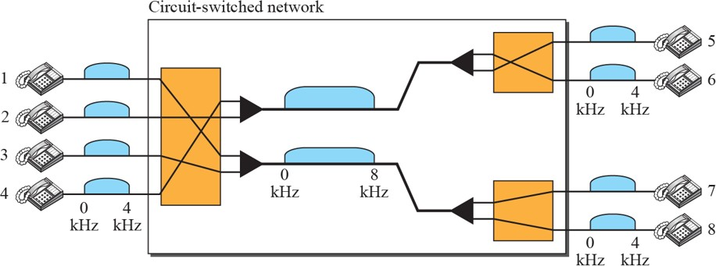
Circuit-Switching Network
Example
Let us use a circuit-switched network to connect eight telephones in a small area. Communication is through 4kHz voice channels. We assume that each link uses FDM to connect a maximum of two voice channels. The bandwidth of each link is then 8 kHz. Telephone 1 is connected to telephone 7; 2 to 5; 3 to 8; and 4 to 6. Of course the situation may change when new connections are made. The switch controls the connections.
8/ 39

Slide 9
Three Phases - Circuit Switching
The actual communication in a circuit-switched network requires three phases:
Connection Setup: Before the two parties (or multiple parties in a conference call) can communicate, a dedicated circuit (combination of channels in links) needs to be established. The end systems are normally connected through dedicated lines to the switches, so connection setup means creating dedicated channels between the switches.
Data Transfer: After the establishment of the dedicated circuit (channels), the two parties can transfer data.
Connection Teardown: When one of the parties needs to disconnect, a signal is sent to each switch to release the resources.
Data Communictions and Networking9/ 39

Slide 10
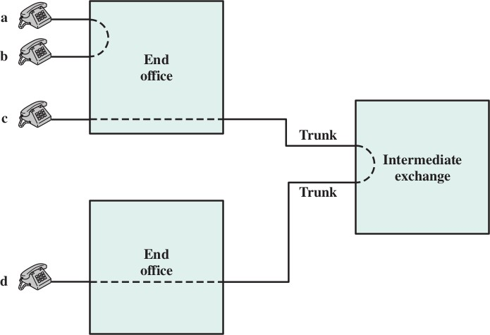
Circuit-Switching Network
Figure:Connection Establishment
Data Communictions and Networking10/ 39

Slide 11
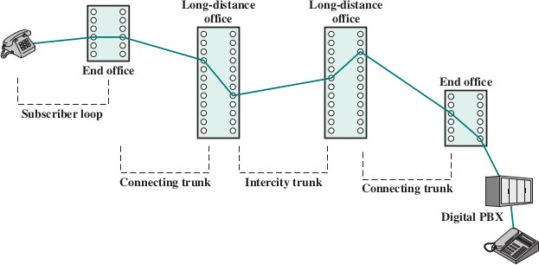
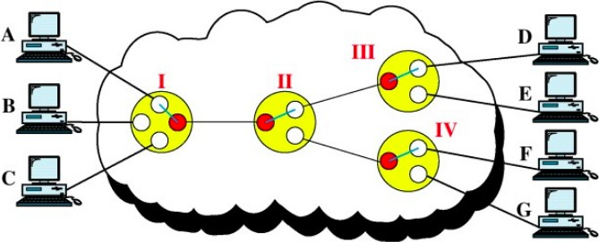
Circuit-Switcing Network
Figure:Example Connection Over a Public Circuit-Switching Network
Data Communictions and Networking11/ 39

Slide 12
Advantages and Dis-Advantages
Advantages:
It uses a fixed bandwidth.
A dedicated communication channel increases the quality of communication.
Data is transmitted with a fixed data rate and No waiting time at switches.
Suitable for long continuous communication.
Dis-Advantages:
A dedicated connection makes it impossible to transmit other data even if the channel is free.
Resources are not utilized fully.
The time required to establish the physical link between the two stations is too long.
As a dedicated path has to be established for each connection, circuit switching is more expensive.
Even if there is no transfer of data, the link is still maintained until it is terminated by users.
Dedicated channels require more bandwidth
Data Communictions and Networking12/ 39

Slide 13
Packet Switching
In data communications, we need to send messages from one end system to another. If the message is going to pass through a packet-switched network, it needs to be divided into packets of fixed or variable size.
The size of the packet is determined by the network and the governing protocol.
In packet switching, there is no resource allocation for a packet. This means that there is no reserved bandwidth on the links, and there is no scheduled processing time for each packet.
Resources are allocated on demand. The allocation is done on a firstcome, first-served basis. When a switch receives a packet, no matter what the source or destination is, the packet must wait if there are other packets being processed.
Two types of packet-switched networks: Datagram networks and
Virtual-circuit networks.

Slide 14
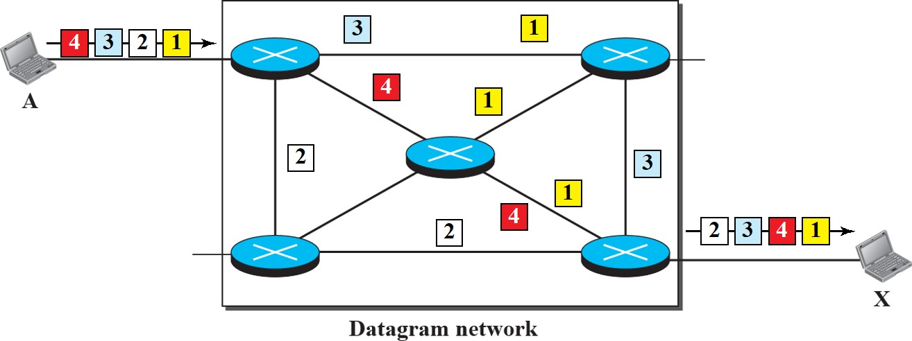
Datagram Approach
In a datagram network, each packet is treated independently of all others. Even if a packet is part of a multipacket transmission, the network treats it as though it existed alone.
Packets in this approach are referred to as datagrams. Datagram switching is normally done at the network layer
Figure:A datagram network with four switches (routers)

Slide 15
Datagram Approach
The datagram networks are sometimes referred to as connectionless networks. The term connectionless here means that the switch (packet switch) does not keep information about the connection state.
There are no setup or teardown phases. Destination Address:
Every packet in a datagram network carries a header that contains, among other information, the destination address of the packet.
When the switch receives the packet, this destination address is examined;
The routing table is consulted to find the corresponding port through which the packet should be forwarded.

Slide 16
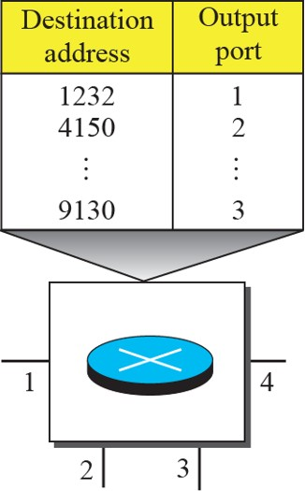
Routing Tables
Routing Tables:
Each switch (or packet switch) has a routing table, which are dynamically updated periodically, based on the destination address.
The destination addresses and the corresponding forwarding output ports are recorded in the tables.
Since, there are no setup or teardown phases, the packets routed to their destinations by the switch using Routing Table in Datagram networks.

Slide 17
Packet Switching - Efficiency and Delay
Efficiency:
It is better than Circuit Switching Network, Resources are allocated, only when there are packets to transfer.
If Source sends a packet and there is a delay of a few minutes before another packet is sent, the resources can be reallocated during these minutes for other packets from other sources.
Delay:
There may be greater delay in Datagram network
Because of No Setup and Teardown phase, each packet may experience a wait time at a switch before it is forwarded

Slide 18
Virtual-Circuit Networks
It is a cross between a Circuit-Switched network and a Datagram network. It has some characteristics of both.
As in a circuit-switched network, there are setup and teardown phases in addition to the data transfer phase.
Resources can be allocated during the setup phase, as in a
circuit-switched network, or on demand, as in a datagram network.
As in a circuit-switched network, all packets follow the same path established during the connection.
As in a datagram network, data are packetized and each packet carries an address in the header (it defines what the next switch should be and the channel on which the packet is being carried).
A virtual-circuit network is normally implemented in the data-link layer, while a circuit-switched network is implemented in the physical layer and a datagram network in the network layer
Data Communictions and Networking18/ 39

Slide 19
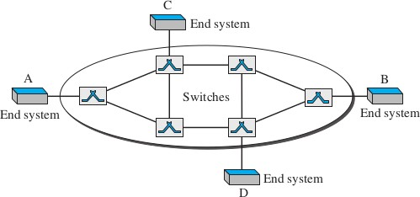
Virtual-Circuit Networks - Addressing
In a VCN, two types of addressing are involved:
Global: A source or a destination needs to have a global address (Unique)
Local(VCI) : The identifier that is actually used for data transfer is called the virtual-circuit identifier (VCI) or the label
Data Communictions and Networking19/ 39

Slide 20
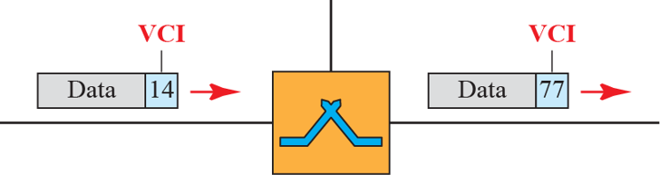
Virtual Circuit Identifier
A VCI is a small number that has only switch scope; it is used by a frame between two switches.
When a frame arrives at a switch, it has a VCI; when it leaves, it has a different VCI.
VCI does not need to be a large number since each switch can use its own unique set of VCIs.

Slide 21
Three Phases - Virtual Circuit Networks
As in a circuit-switched network, a source and destination need to go through three phases in a virtual-circuit network:
Setup Phase: The source and destination use their global addresses to help switches make table entries for the connection.
Data transfer Phase: Data transfer occurs between these two phases.
Teardown: The source and destination inform the switches to delete the corresponding entry.
We first understand theData transfer Phase, which is more straightforward; and then about theSetup PhaseandTeardown Phase
Data Communictions and Networking21/ 39

Slide 22
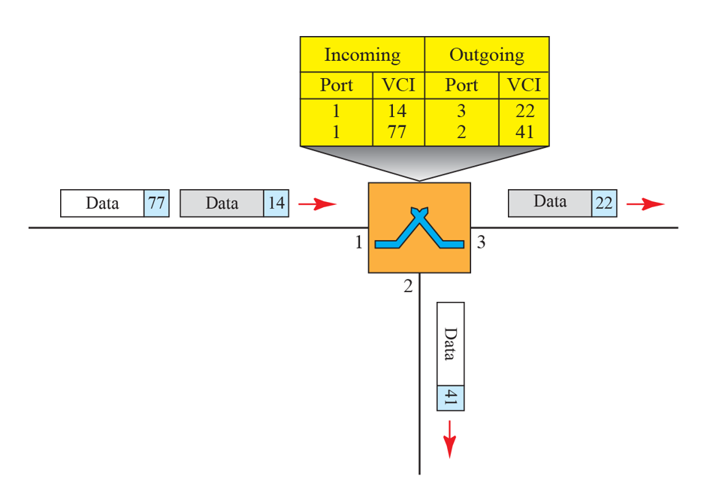
Three Phases
Data Transfer Phase
To transfer a frame from a source to its destination, all switches need to have a table entry for this virtual circuit.
The table, in its simplest form, has four columns. This means that the switch holds fourpieces of information for each virtual circuit that is already set up.
This Phase is active until the source sends all its frames to the destination. The process creates a virtual circuit, between the source and destination
Data Communictions and Networking22/ 39

Slide 23
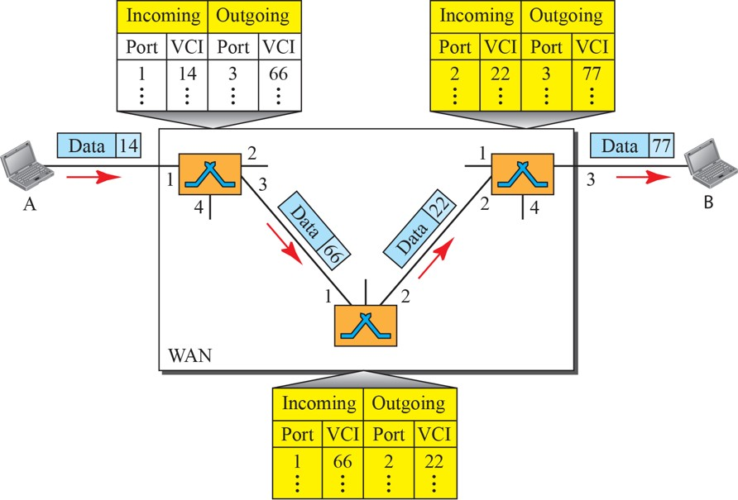
Three Phases - Virtual Cirucit Networks
Figure:Source-to-Destination data transfer in a Virtual-Circuit network
Data Communictions and Networking23/ 39

Slide 24
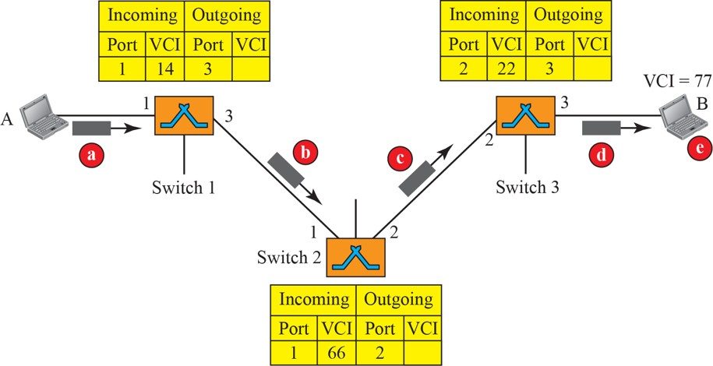
Three Phases - Virtual Cirucit Networks.....!
Setup Request Phase: A setup request frame is sent from the source to the destination.
Figure:Setup Request in a Virtual-Circuit network
Data Communictions and Networking24/ 39

Slide 25
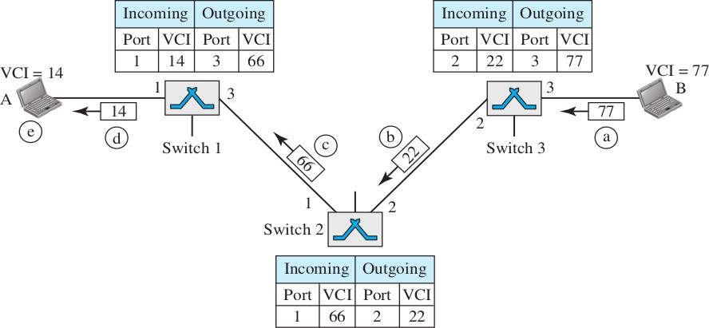
Three Phases - Virtual Cirucit Networks.....!
Setup Ack. Phase: A Setup Ack. frame is sent from the Destination to Source
Figure:Setup Acknowledgment in a Virtual-Circuit Network
Data Communictions and Networking25/ 39

Slide 26
Virtual-Circuits Network
Teardown Phase
Source A, after sending all frames to B, sends a special frame called a teardown request. Destination B responds with a teardown confirmation frame. All switches delete the corresponding entry from their tables.
Important Note:-
In virtual-circuit switching, all packets belonging to the same source and destination travel the same path, but the packets may arrive at the destination with different delays if resource allocation is on demand.
Data Communictions and Networking26/ 39

Slide 27
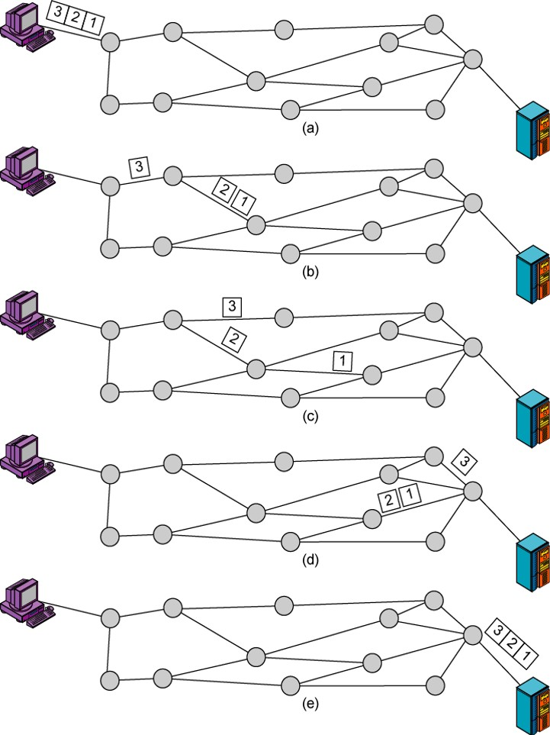
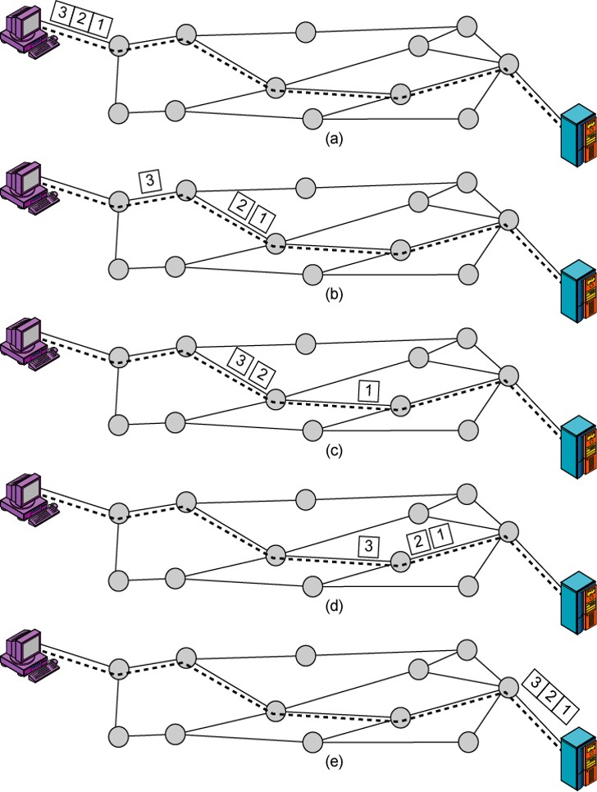
Datagram and Virtual Circuit
Figure:Datagram Approach
Figure:Virtul Circuit Approach
Data Communictions and Networking27/ 39

Slide 28
Switching Networks
Comparision of Switching Networks
BASIS FOR COMPARISON | CIRCUIT SWITCHING | PACKET SWITCHING
Orientation | Connection oriented. | Connectionless.
Purpose | Initially designed for Voice communication. | Initially designed for Data Transmission.
Flexibility | Inflexible, because once a path is set all parts of a transmission follows the same path. | Flexible, because a route is created for each packet to travel to the destination.
Order | Message is received in the order, sent from the source. | Packets of a message are received out of order and assembled at the destination.
Technology /Approach | It can be achieved using two Technologies (FEM/TDM) | It has two approaches Datagram & Virtual Circuit Approach.
Layers | Itis implemented at Physical Layer. | Implemented at Network Layer.
Data Communictions and Networking28/ 39

Slide 29
Switching Networks
Comparision of Switching Networks
Circuit Switching | Datagram Packet Switching | Virtual circuit Packet switching
Dedicate transmission path | No Dedication Path
Continuous transmission of data | Transmission of packets
Fast enough for interactive
Message are not stored | Packets may be stored until delivered | Packets stored until delivered
The path is established for entire conversation | Route established for each packet | Route established for entire conversation
Call setup delay; negligible transmission delay | Packet transmission delay | Call setup delay; Packet transmission delay
Busy signal if called party busy | Sender may be notified if packet not delivered | Sender notified of connection denial
Data Communictions and Networking29/ 39

Slide 30
Switching Networks
Comparision of Switching Networks
Circuit Switching | Datagram Packet Switching | Virtual circuit Packet switching
Overload may block call setup; no delay for established calls | Overload increases packet delay | Overload may block call setup; increases packet delay
Electromechanical switching nodes | Small switching nodes
User responsible for message loss protection | Network may be responsible for individual packets | Network may be responsible for packet sequences
Usually no speed or code conversion | Speed and code conversion
Fixed bandwidth | Dynamic use of bandwidth
No overhead bits after call setup | Overhead bits in each packet
Data Communictions and Networking30/ 39

